Slide 1
Infosys_ElectViz
Election Data Visualization for media
Infosys Springboard Virtual Internship- 6.0
Batch-11
Group - 1
Mentor :
Mrs. Nithyasri S J
By:
B. Nandhini

Slide 2
Introduction
Elections generate large, complex datasets involving candidates, parties, voters and constituencies.
Manual analysis of election data is time-consuming and error-prone.
ElectViz is an interactive Power BI dashboard designed to:
  Analyze Indian election data across multiple years
  Identify party performance, voter behavior and winning patterns
  Support data-driven insights for political analysis
Objective:
To transform raw election data into clear, interactive and meaningful visual insights.

Slide 3
System Design and Workflow
Data Collection
  Historical Indian election data (candidates, votes, constituencies, parties, demographics)
Data Pre-processing
  Data cleaning and formatting
  Handling missing values
  Creating calculated columns and measures using DAX
Data Modelling
  Establishing relationships between tables
  Optimizing star schema for performance
Visualization (Power BI)
  Interactive dashboards
  Filters, slicers, drill-down features
Insight Generation
  Trend analysis
  Party performance comparison
  Electability and winning factor evaluation
Data Source
ETL / Data pre-processing
Data Storage
Data Modelling
Power BI Reports
Decision and Insights

Slide 4
Milestones
Milestone 1: Data Preparation & Modeling
Data understanding, dataset exploration, and data cleaning performed.
Initial data modeling and relationships established in Power BI.
Milestone 2: Core Dashboard Development
Developed key dashboards: Election Overview, Party Performance, and Gender Distribution.
Focused on foundational insights and comparative analysis.
Milestone 3: Advanced Analytics Implementation
Built advanced dashboards for Candidate Demographics and Electability analysis.
Created custom DAX measures for deeper performance insights.
Milestone 4: Trend & Outcome Analysis
Implemented Trend Analysis and Winning Factor dashboards.
Final insights derived and complete project documentation prepared.

Slide 5
Dashboard Overview
ElectViz consists of 7 analytical pages:
Election Overview
Party Performance Analysis
Gender Distribution Analysis
Candidate Demographic Analysis
Electability Analysis
Trend Analysis
Election Outcome & Winning Factor Analysis
Each page focuses on a specific analytical objective.

Slide 6
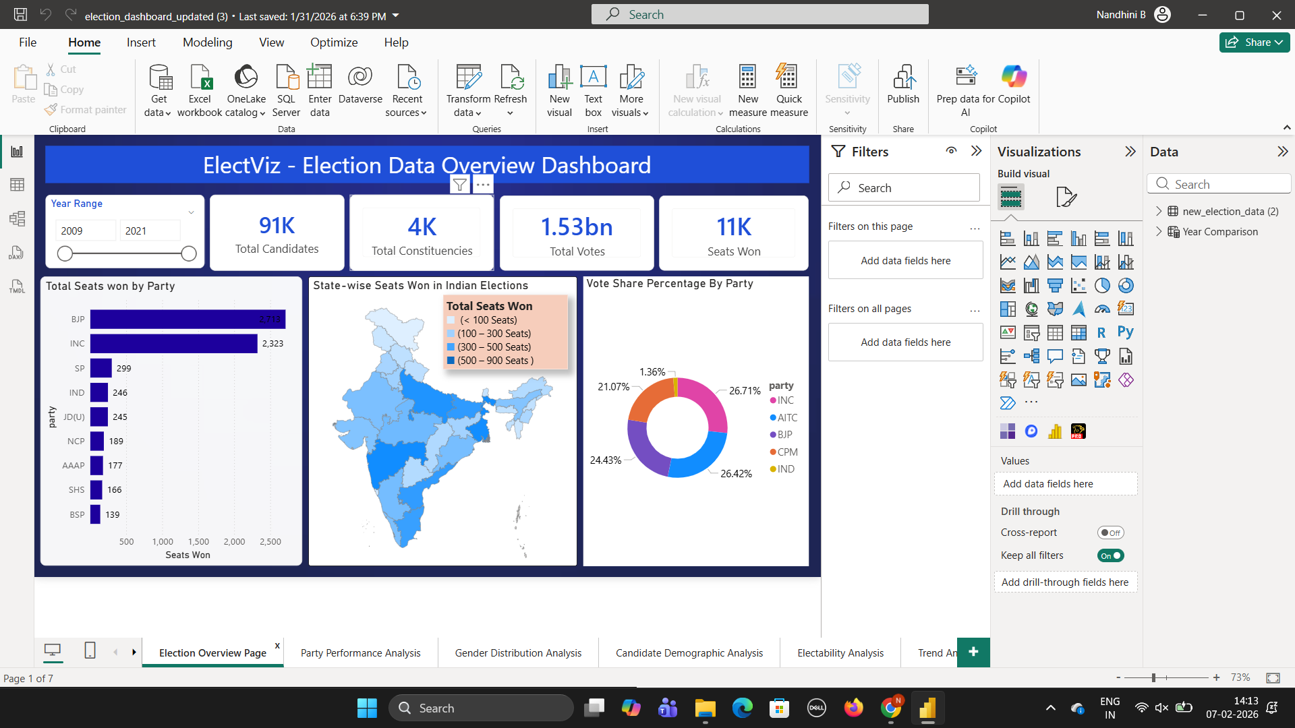
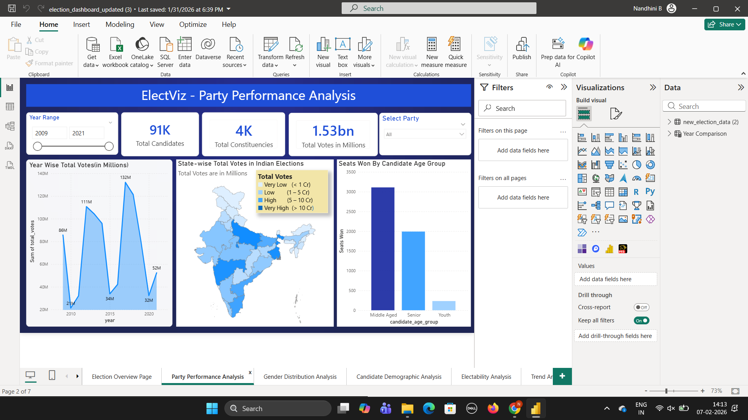
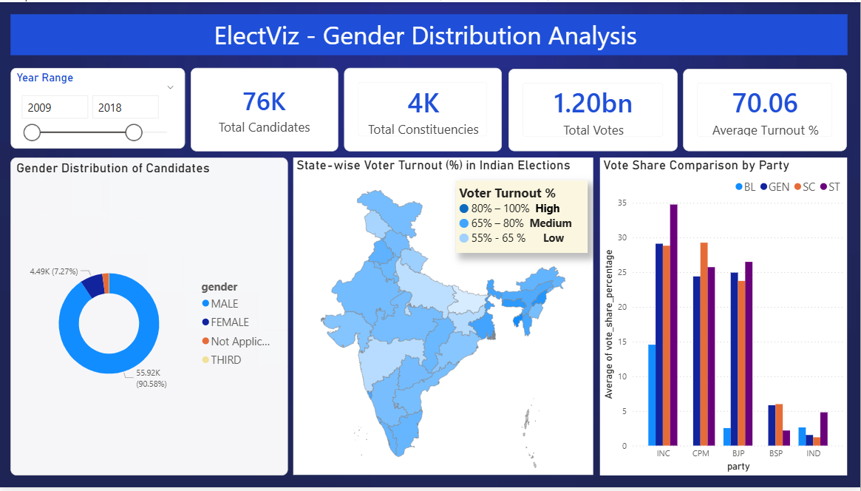
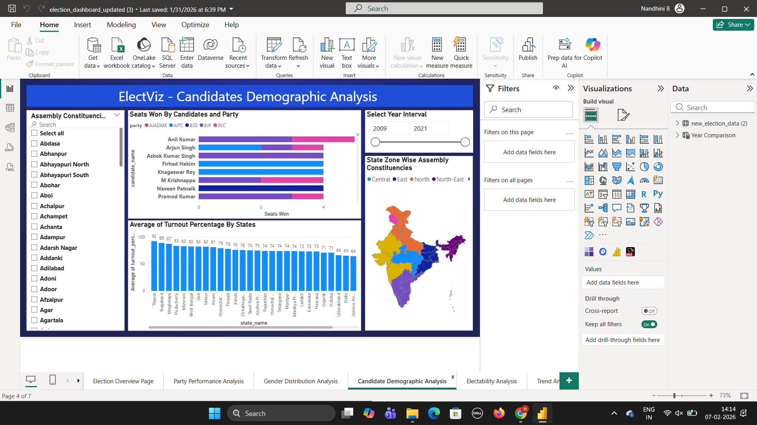
Screenshots

Slide 7
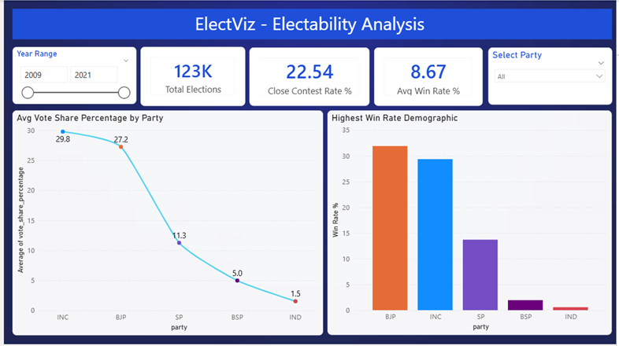
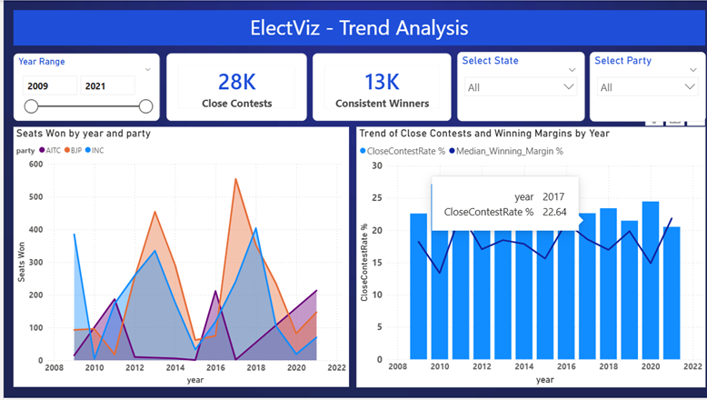
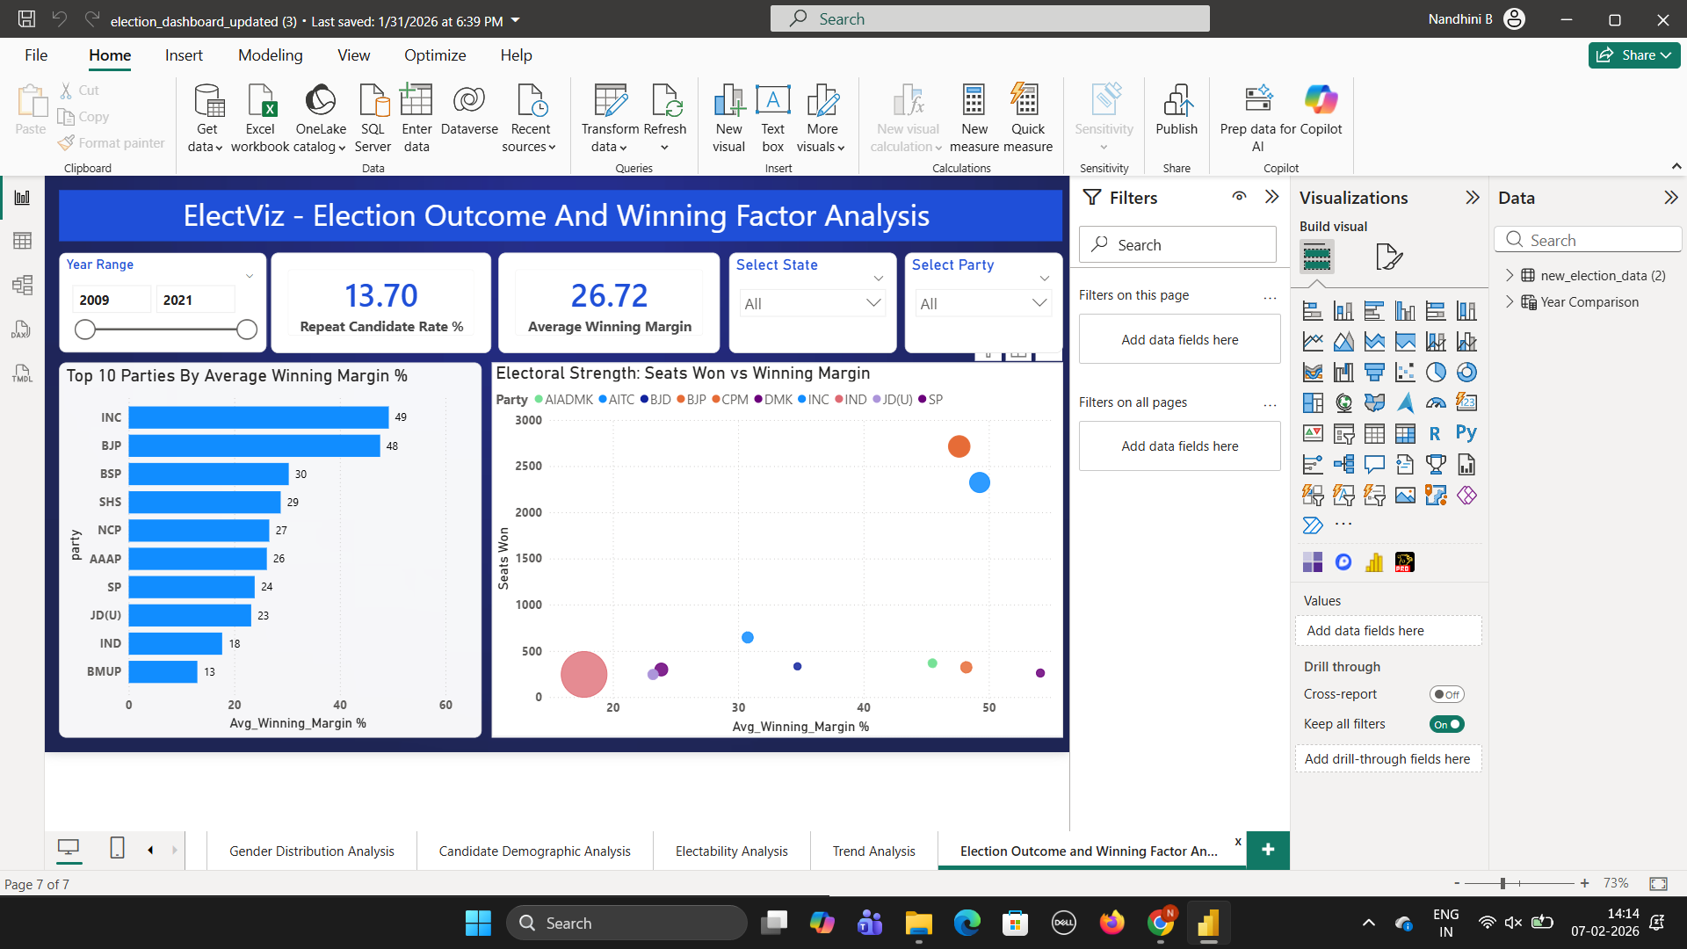

Slide 8
Key Insights and Purpose
1. Overview Dashboard:
Key Insight: Seat dominance contrasts with competitive vote share and shrinking margins.
Purpose: To highlight national electoral trends and overall competition patterns.
2. Party Performance Dashboard
Key Insight: Few parties dominate wins, while regional strength and vote-seat gaps persist.
Purpose: To evaluate party dominance, performance shifts and electoral efficiency.
3. State-wise Analysis Dashboard
Key Insight: Electoral outcomes and turnout vary significantly by region.
Purpose: To understand state-level political behavior and regional influence.
4. Candidate Demographics Dashboard
Key Insight: Mid-aged, experienced, and repeat candidates show higher success rates.
Purpose: To assess how demographics and background impact electability.
5. Constituency-level Insights Dashboard
Key Insight: Swing seats and narrow margins heavily influence overall results.
Purpose: To identify competitive constituencies and local electoral dynamics.
6. Winning Margin & Trend Dashboard
Key Insight: Declining margins indicate rising competition and electoral volatility.
Purpose: To track competitiveness trends and identify stronghold vs battleground areas.

Slide 9
Future Enhancements
Integration of real-time election data
Advanced predictive analytics using ML
Sentiment analysis using social media data
Constituency-level forecasting
Web-based deployment for public access

Slide 10
Conclusion
ElectViz successfully converts raw election data into actionable insights
Enables:
Better understanding of political performance
Identification of voter and candidate trends
Data-driven decision making
The dashboard is interactive, scalable and insightful
Can be extended for future elections and predictive analysis

Slide 11
Acknowledgements and References
Acknowledgements:
We would like to express our heartfelt gratitude to:
Infosys Springboard Team – for organizing this valuable internship opportunity.
Our Mentor(Nityashree Ma'am) – for her continuous support and feedback.
My Teammates – for collaboration, encouragement and insights.
This internship has been a significant step in our professional growth and technical journey.
References:
Election Dataset Source – Kaggle
Dataset Link: [https://www.kaggle.com/datasets/awadhi123/indian-election-dataset?select=indian-state-level-election.csv]
Infosys Springboard Virtual Internship – Course materials and resources

Slide 12
Thank You!

